Slide 1
Chiba Campaign Daily Report 2018/11/06
Al Mashroor Fatmi

Slide 2
Site Name: Chiba University
Additional Site Information: $N 35°{37}^{′}{30}^{′′}, E 140°{06}^{′}14′′$
Elevation: 60m
Instrument: Sky Radiometer
*AOT Data by AERONET observation not available since 1st Nov, 2018

Slide 3
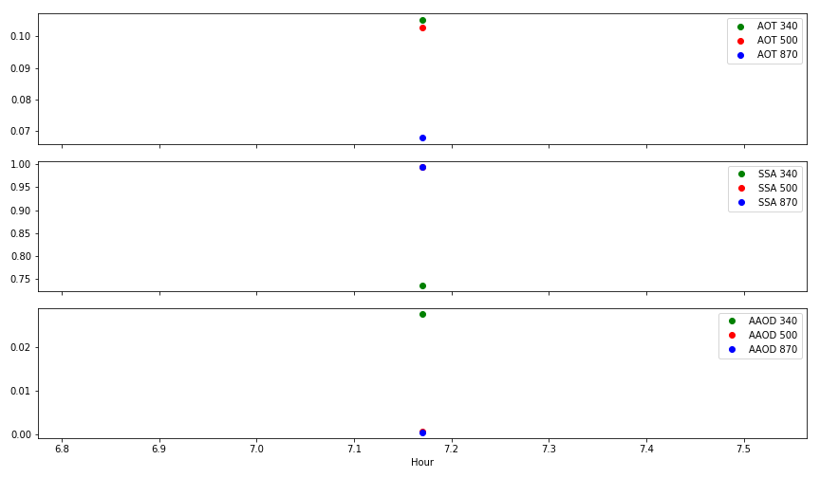
AOT, SSA, AAOD at wavelengths of 340, 500, 870 nm on 6th Nov, 2018 observed by Sky Radiometer

